Slide 1
Discussion 10 - Iterators & Streams
Chris Allsman

Slide 2
Administrivia
HW9 Due Fri
Scheme Project Phase II due today
Phase III shorter but has really hard questions
Attendance not up-to-date, but will be by end of week

Slide 3
Iterators

Slide 4
Iterables/Iterators
Iterable: a collection of values that can be iterated over (in a for loop)
Iterator: a “pointer” that
Returns the next item in a sequence
Can “move forward” one element in that sequence
iter(iterable) gives an iterator
next(iterator) does the things described above

Slide 5
Example
>>> lst = [1, 2]
>>> lst_iter = iter(lst)
>>> next(lst_iter)
>>> next(lst_iter)
>>> next(lst_iter)
1
2
1
2
StopIteration

Slide 6
For Loops
iterator = iter(iterable)
while True:
try:
x = next(iterator)
do_something(x)
except StopIteration:
break #stop iterating
for x in iterable:
do_something(x)
1) Create iterator over iterable
2) get the next value of the iterator
3) assign to a variable, use it in the body of the for loop
4) Stop once a StopIteration exception is raised

Slide 7
Iterators and Iterables?
You can call iter on most iterators
Returns the exact same iterator
>>> lst = [1, 2, 3]
>>> i1 = iter(lst)
>>> i2 = iter(i1)
>>> next(i1)
1
>>> next(i2)
2

Slide 8
Generators
Look like functions, but have a yield statement in their body
When called, return a generator object
You do not go into their body at this point
Calling next on a generator object will evaluate each line of code up to a yield statement, halt execution, and return it
Raise a StopIteration once you’ve exited the function

Slide 9
def countdown_gen(n):
print(“inside!”)
while n > 0:
yield n
n -= 1
>>> g = countdown_gen(2)
>>> next(g)
>>> next(g)
>>> next(g)
inside!
2
1
StopIteration

Slide 10
Yield from & Built-ins
yield from iterable
for i in iterable:
yield i
range(start, stop) -> iterable
map(f, iterable) -> iterator
filter(f, iterable) -> iterator

Slide 11

Attendance
links.cs61a.org/chris-disc
MW: amp

Slide 12
Streams

Slide 13
Lazy Evaluation
Don’t evaluate something until it is needed
Ex. didn’t evaluate body of generator until we hit it when calling next()
Streams use lazy evaluation to delay evaluation of elements in a sequence

Slide 14

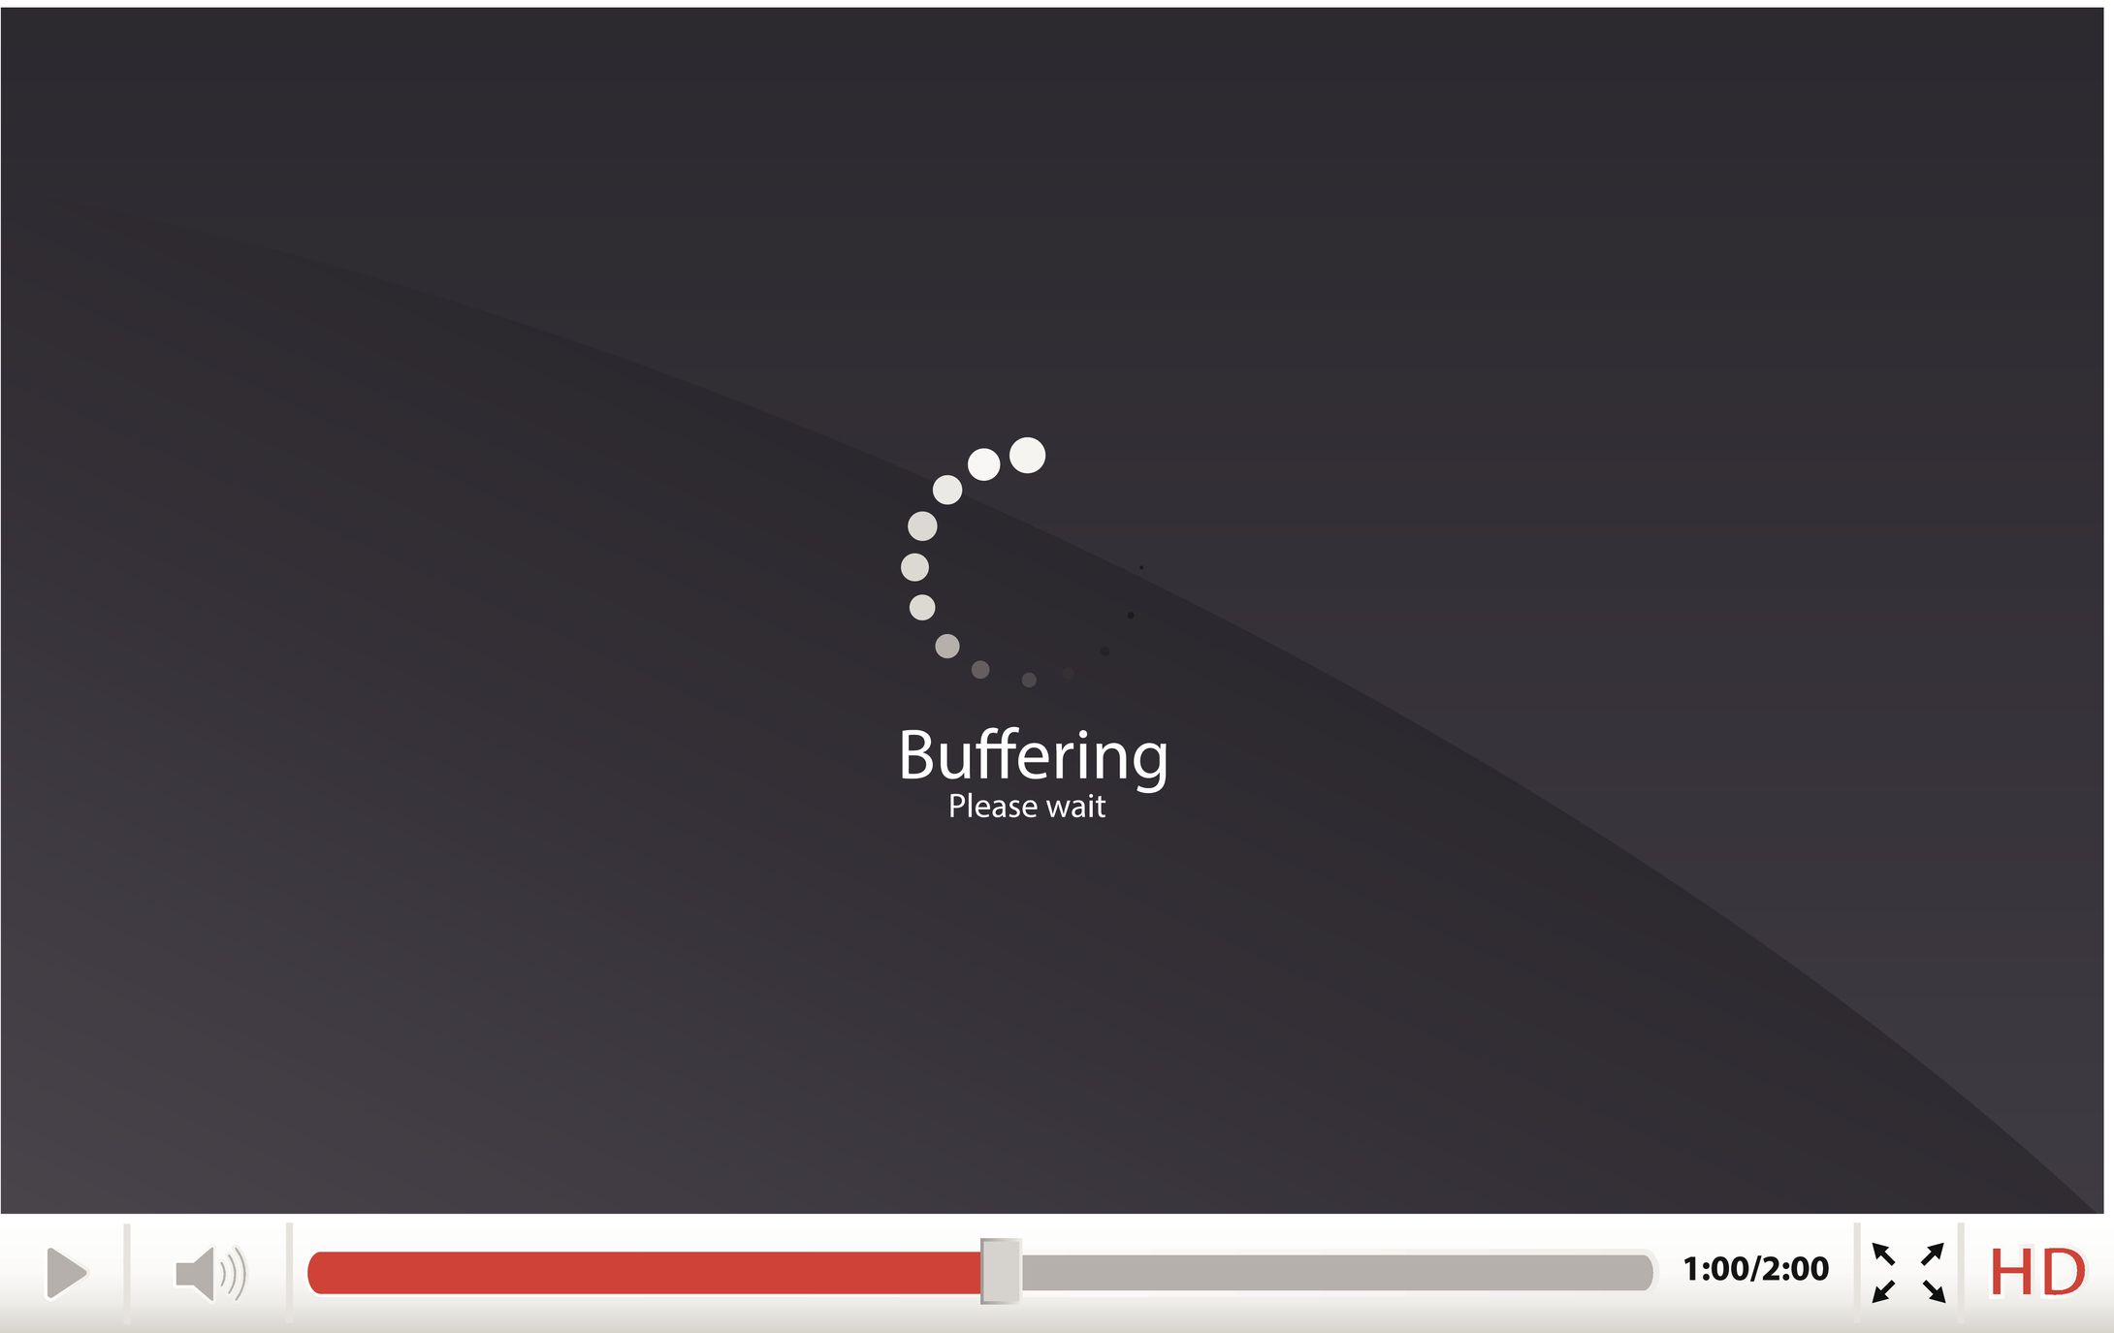
Streams
Lists
Streams
Notes:
What are some advantages to using streams over lists?

Slide 15
Streams
Streams - Scheme lists with lazy evaluation
Promise - an expression that evaluates to a value only when asked to
Not forced - the promise hasn’t been evaluated yet.
Forced - the promise has already been evaluated.
Once a promise has been forced, the resulting value is evaluated and saved

Slide 16
Lists vs. Streams
nil is the empty list
cons can create a list by evaluating both its operands, where the second operand evaluates to a list
car returns the first element of the list
cdr returns the rest of a list
nil is the empty stream
cons-stream creates a stream by evaluating its operand and storing the second operand for later computation
car returns the first element of the stream
cdr-stream computes and returns the rest of a stream

